Slide 1
Estimation

Slide 2
Inferential Statistics
Estimation
Hypothesis
Testing
Point
estimation
Interval
Estimation

Slide 3
Point Estimation
Values to be sample population
computed
Mean x μ
Difference x₁ – x₂ μ₁ – μ₂
St. Dev. s σ
Proportion p π
Difference
Of proportion p₁ – p₂ σ₁ – σ₂

Slide 4
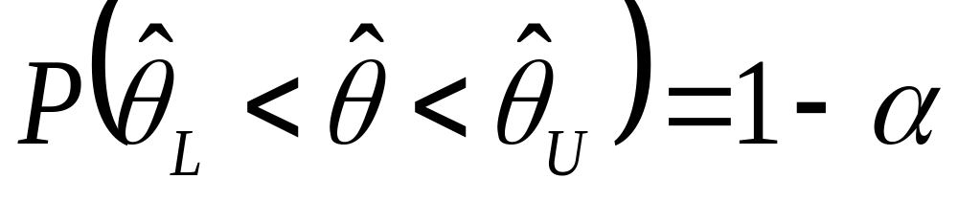
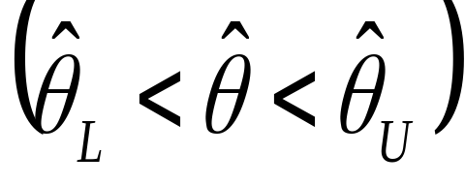
Interval Estimation
Significance level
→ 100(1-α) % confidence interval
Confidence limits
Confidence coefficient/
Degree of confidence
The wider the interval, the higher the
confidence level.

Slide 5
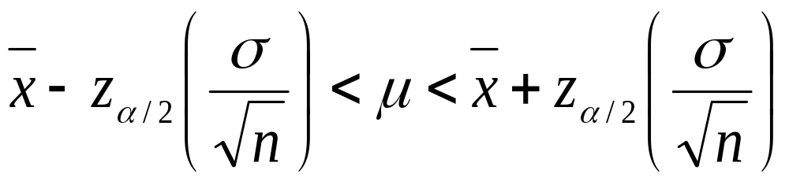


Interval Estimate of the Mean
1 - α
μ
Critical values

Slide 6
Critical Values
Confidence α α/2 Critical value
Level z_{α/2}
90% 0.10 0.050
91% 0.09 0.045
92% 0.08 0.040
93% 0.07 0.035
94% 0.06 0.030
95% 0.05 0.025
96% 0.04 0.020
97% 0.03 0.015
98% 0.02 0.010
99% 0.01 0.005

Slide 7
Estimation About the Mean
Large Sample
  a. Variance is known
  b. N>30
    Assume σ = s
Sample size estimation
Small Sample
  a. Variance is unknown and n<30

Slide 8
Example
A study of 40 bowlers showed that their average
score was 186. The standard deviation of the
population is 6. Construct the 95% confidence
interval of the mean scores for all bowlers.

Slide 9
Example
An electrical firm manufactures light bulbs that
have a length of life that is approximately normally
Distributed with a standard deviation of 40 hours.
If a sample of 30 bulbs has an average life of 780
Hours, find the 96% confidence interval for the
population mean of all bulbs produced by this firm

Slide 10
Example
A certain medication is known to increase the
pulse rate of its users. The standard deviation
of the pulse rate is known to be 5 beats.
A sample of 25 users had an average pulse
rate of 104 beats per minute. Find the 99%
confidence interval of the true mean.

Slide 11
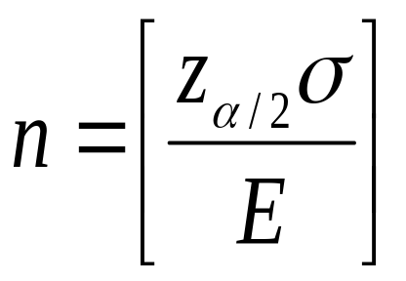
Sample Size for Mean Estimates
2
Example:
Prof. X wants to estimate the mean height of his students.
How many students should he consider for his sample if
he wants to be 99% sure that the mean is within 0.25 inch
of the true population mean? Assume that σ = 1.1 inch.

Slide 12
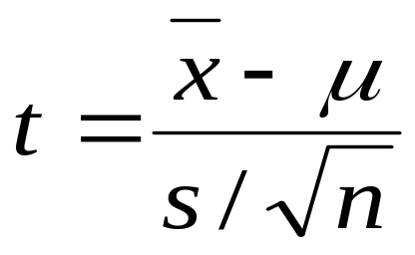
Small Sample Estimation
Assumptions:
1. σ is unknown
2. Sample size is small (n ≤ 30)
3. The parent population is approximately normal.
Theorem:
If x and s² are the mean and variance, respectively of a
random sample of size n taken from a population that is
normally distributed with mean μ and variance σ² then
is the value of a random variable T having the t-distribution
with v = n – 1 degrees of freedom.

Slide 13

Interval Estimate of the Mean
1 - α
μ
Critical values

Slide 14
Example
A machine is producing metal pieces that are
cylindrical in shape. A sample of pieces is taken
and the diameters are 1.01, 0.97, 1.03,1.04,0.99,
0.98, 0.99, 1.01 and 1.03 centimeters. Find a 99%
confidence interval for the mean diameter of pieces
from this machine assuming an approximate normal
distribution.

Slide 15
Estimation About Mean Differences
Large Sample
  a. Variance is known
  b. N>30
    Assume σ = s
Small Sample (n<30)
  Variance is unknown and unequal
  Variance is unknown and equal
Paired Observation

Slide 16
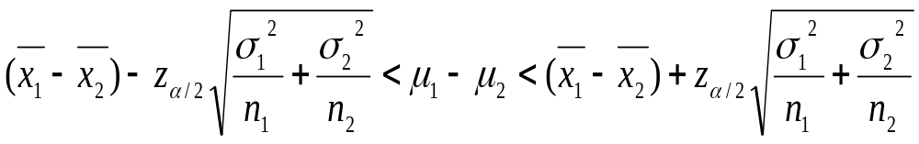
Estimate for the Difference of Means
If x₁ and x₂ are the means of two independent random
samples of size n₁ and n₂ from a population with
known variances σ₁² and σ₂², respectively, a
100(1-α)% confidence interval for μ₁ - μ₂ is given by

Slide 17
Example
A random sample of size n₁ = 25 taken from a normal
population with a standard deviation of σ₁ = 5 has a
mean x₁ = 80. A second random sample of size n₂=36
taken from a different normal population with a
standard deviation σ₂= 3, has a mean x₂ = 75. Find
the 95% CI for the difference of the population means.

Slide 18
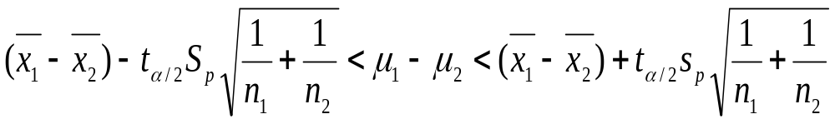
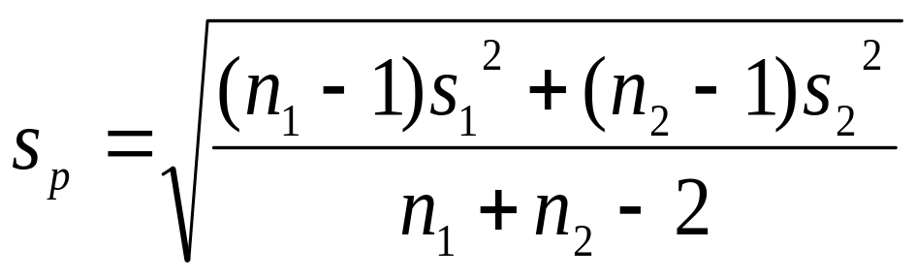
Estimate for the Difference of Means
If x₁ and x₂ are the means of two independent random
samples of size n₁ and n₂ from a population with
unknown but equal variances, a 100(1-α)% CI for
μ₁ - μ₂ is given by
where

Slide 19
Example
A course in statistics is taught to 12 students by the
conventional classroom procedures. A second group of 10
students was given to the same course by means of a
programmed material. At the end of the term, the same
exam was given to each group. The 12 students gave an
average grade of 85 with a standard deviation of 4, while
the 10 students gave an average of 81 with a standard
deviation of 5. Find the 90% CI for the difference between
the population means, assuming the populations are
normally distributed with equal variances.

Slide 20
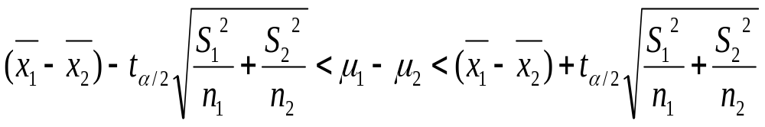
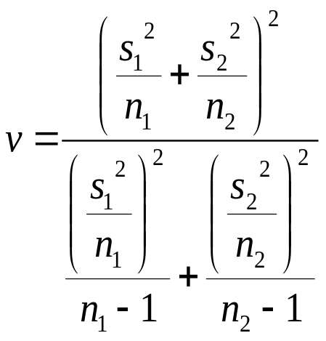
Estimate for the Difference of Means
If x₁ and x₂ are the means of two independent random
samples of size n₁ and n₂ from a population with
unknown and unequal variances, a 100(1-α)% CI for
μ₁ - μ₂ is given by
where

Slide 21
Example
A taxi company is trying to decide whether to purchase brand A
Or brand B tires for its fleet of taxis. To estimate the difference
Of two brands, an experiment is conducted using 12 of each
Brand. The tires are run until they are worn out. The results
Are
Brand A Brand B
Mean 36 300 km 38100 km
Standard Dev 5 000km 6 100 km
Compute for the 95% confidence interval for u₁ - u_{2,}assuming
The populations to be normally distributed and variances
unequal

Slide 22
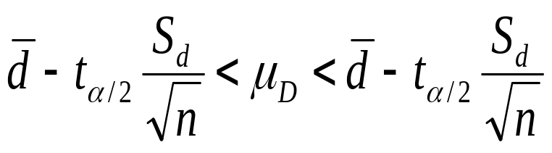
Estimate for Paired Observations
If d and s_{d} are the mean and standard deviation of the
normally distributed differences of n random pairs of
Measurements, a (1-a)100% confidence interval for u_{D}
Where
V=n-1

Slide 23
Example
The government awarded grants to the agricultural departments of 9 universities to test the yield capabilities of two new varieties of wheat. Each variety was planted on plots of equal area at each university and the yields, in kg are recorded as follows:
University
Variety 1 2 3 4 5 6 7 8 9
1 38 23 35 41 44 29 37 31 38
45 25 31 38 50 33 36 40 43
Find a 95% confidence interval for the mean difference between the yields of the two varieties, assuming the yields of the two varieties to be approximately normally distributed

Slide 24
Estimation on Proportions
Proportions
Difference of proportions

Slide 25
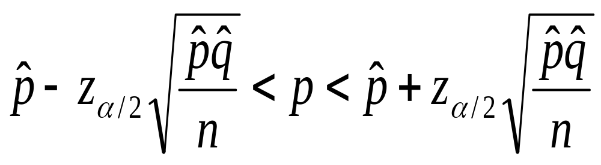
Estimate for Proportion
If p is the proportion of success in a random sample of
size n, and q = 1- p, an approximate (1-a) 100%
confidence interval for the binomial parameter p is
given by

Slide 26
Example
Compute a 98% confidence interval for the proportion of defective items in a process when it is found that a sample size 100 yields 8 defective.

Slide 27
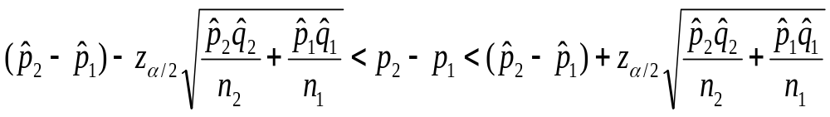
Estimate for Difference of Proportion
If p is the proportion of success in a random sample of
size n, and q = 1- p, an approximate (1-a) 100%
confidence interval for the binomial parameter p is
given by

Slide 28
Example
Ten engineering schools in the US were surveyed. The sample contained 250 electrical engineers, 80 being women; 175 chemical engineers, 40 being women. Compute a 90% confidence interval for the difference between the proportion of women in these two fields of engineering. Is there a significant difference between the two proportions?

Slide 29
Estimate for Difference of Proportion
If p is the proportion of success in a random sample of
size n, and q = 1- p, an approximate (1-a) 100%
confidence interval for the binomial parameter p is
given by

Slide 30
Example
Ten engineering schools in the US were surveyed. The sample contained 250 electrical engineers, 80 being women; 175 chemical engineers, 40 being women. Compute a 90% confidence interval for the difference between the proportion of women in these two fields of engineering. Is there a significant difference between the two proportions?

Slide 31
Estimation about variances
Single sample
  Chi Squared
Ratio Of Variance
  F distribution

Slide 32
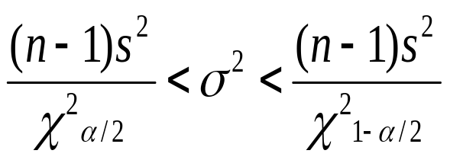
Estimate for Single Sample Variance
If s² is the variance of a random sample size n, from a
Normal population, a (1- α)100% confidence interval
for σ² is
V = n-1

Slide 33
Example
A manufacturer of car batteries claims that his
batteries will last, on average, 3 years with variance
of 1 year. If 5 of these batteries have lifetimes of 1.9,
2.4,3.0,3.5, and 4.2 years, construct a 95% confidence
interval for σ and decide if the manufacturer’s claim
that σ = 1 is valid. Assume the population of battery
lives to be approximately normally distributed.

Slide 34
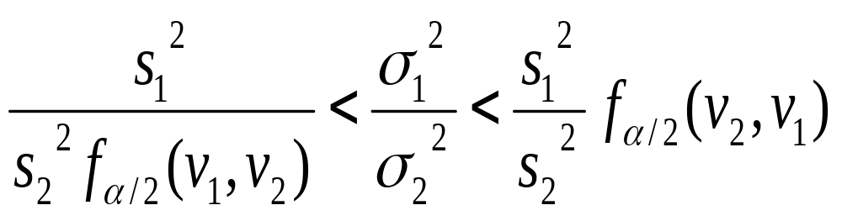
Estimate for Two Sample:Ratio of Variance
If s₁² and s₂² are the variances of independent samples
of size n, from a Normal population, a (1- α)100%
confidence interval
for σ₁ ² / σ₂ ² is

Slide 35
Example
A taxi company is trying to decide whether to purchase brand A or brand B tires for
its fleet of taxis. To estimate the difference of two brands, an experiment is
conducted using 10 of each brand. The tires are run until they are worn out.
The results are
Brand A Brand B
Mean 36 300 km 38100 km
Standard Dev 5 000km 6 100 km
Compute for the 95% confidence interval for u₁ - u_{2,}assuming
The populations to be normally distributed and variances
unequal
Construct a 90% confidence interval for σ₁/σ₂ for the said
problem and can we assume that σ₁=σ₂ when we construct our
confidence interval for µ₁-µ₂?

